Slide 1
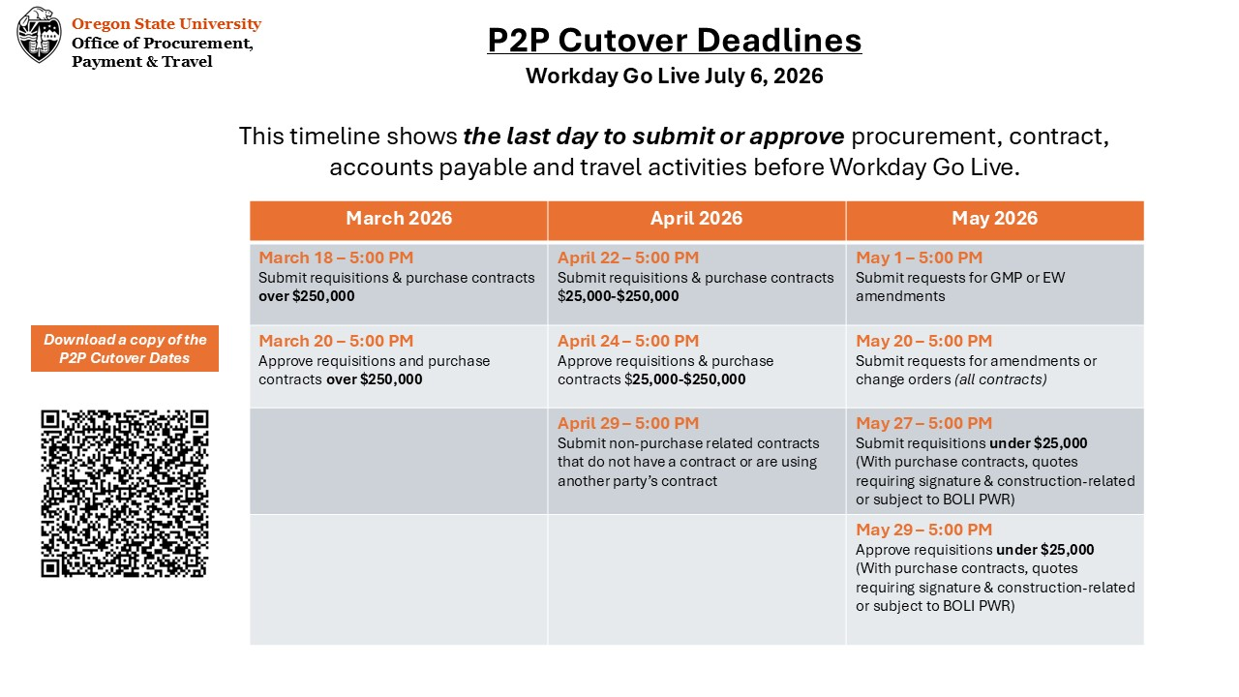

Slide 2
June 3 – 5:00 PM
Submit contracts using an OSU template that are not tied to a purchase
Request a brand-new supplier
Submit a reimbursement request for a non-employee first time set up
Enter an invoice not tied to a PO that requires a new supplier
Submit a BennyBuy payment request that requires a new supplier
Enter a Banner invoice that requires a new supplier
June 8 – 12:00 PM
Submit requisitions under $25,000 (Without purchase contracts, quotes requiring signature & not construction-related or subject to BOLI PWR)
June 9 – 5:00 PM
Enter an invoice tied to a purchase order
Submit electronic supplier invoices through BennyBuy
Create a receipt
June 10 – 5:00 PM
Approve purchases under $25,000 (Without purchase contracts, quotes requiring signature & non-construction related or subject to BOLI PWR)
June 11
12:00 PM
Request updates to an existing supplier (such as an address change)
5:00 PM
Approve purchase order invoices (All Approvers)
June 12 – 5:00 PM – Banner Snapshot
Request new activity codes be added to Concur
June 17 – 5:00 PM
Submit an expense report in Concur
Reconcile Banner FY26 cash advances
Request Concur budget authority changes
June 18 – 5:00 PM
Submit a reimbursement request for existing non-employees
Request Concur budget authority delegation
June 22 – 5:00 PM
Enter a non-PO invoice for existing suppliers
Submit a BennyBuy payment request (for existing suppliers
Enter a Banner non-PO invoice for existing suppliers
June 23 – 5:00 PM
Approve expense reports in Concur
Approve travel requests in Concur
Submit a cash advance request in Concur
June 26 – 5:00 PM
Approve cash advance requests in Concur
Approve non-employee reimbursements
Approve BennyBuy non-PO invoices
Approve BennyBuy payment request
Approve Banner non-PO invoices
June 30
3:00 PM
Final Accounts Payable check run
Final Athletics check run
5:00 PM
Departments can email invoices to Accounts Payable
July 6
Workday Go Live!

